Slide 1
Walton supermarket
Elie Bensoussan
Lucas Blazkowski
Loïc Colliot
BUSINESS STRATEGY

Slide 2
Sales Manager
Mission | KPI
Increase the number of units sold by purchase | units sold by purchase
Identify the 3 less profitable and 3 more profitable store. | sum of the revenue by city average revenue per purchase by city
Identify the best and the worst product | sum of the revenue by product category and by state.

Slide 3
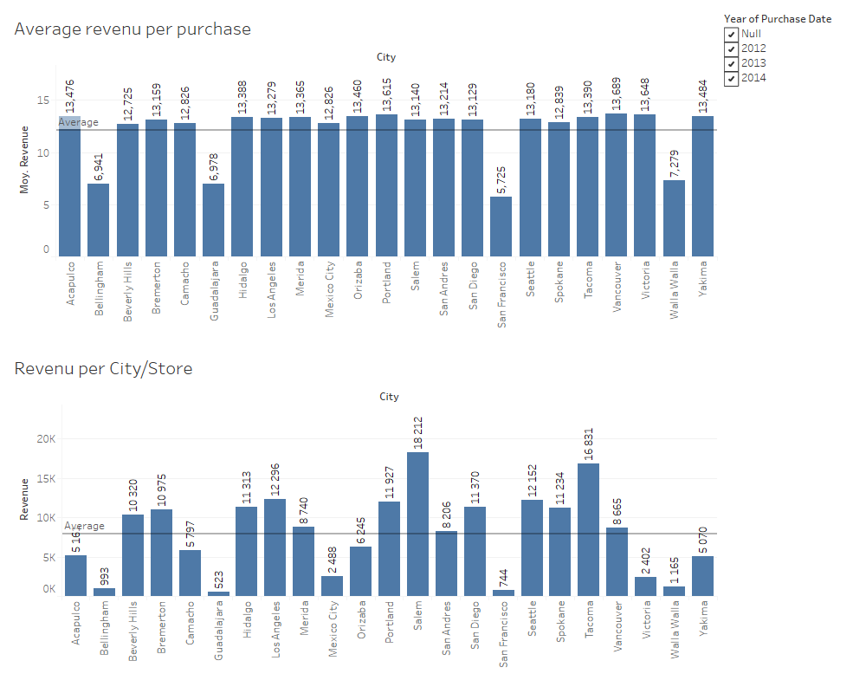

Slide 4
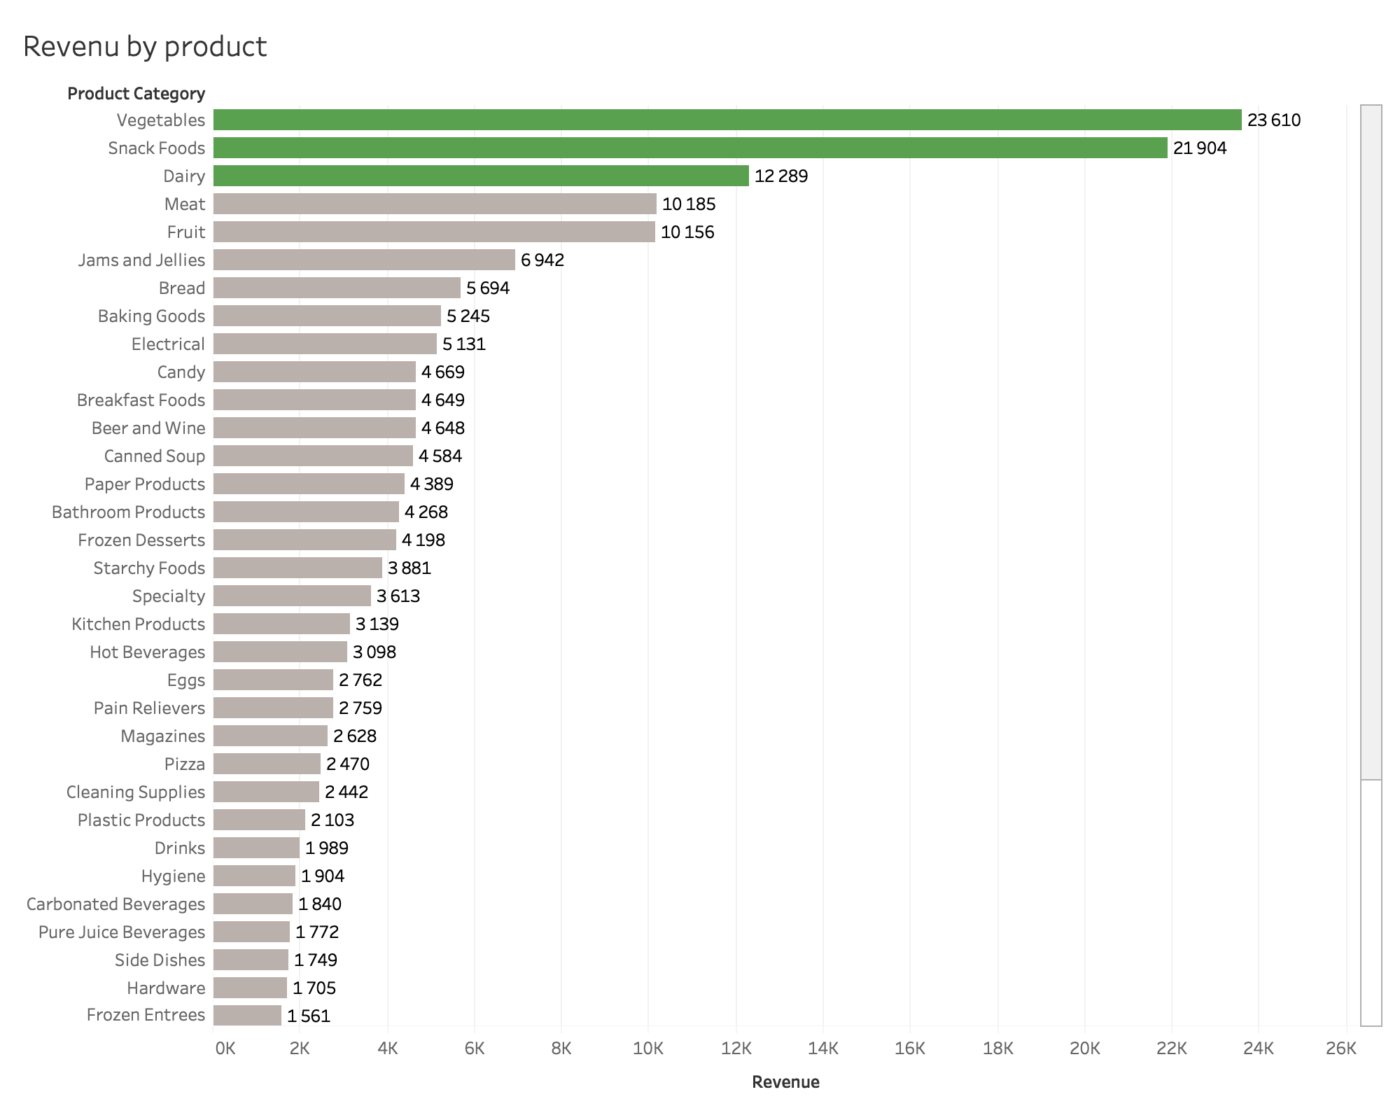

Slide 5
Sales Manager Recommendations
Most profitable stores : tacoma , Salem
Less profitable stores (less revenu and less average revenu per purchase) : San francisco , guadalajara, bellingham, walla walla
So , our recommendation are to close some less profitable stores like San Francisco or Guadalajara and invest in city with a huge revenu like Tacoma .
Our worst products are frozen entrees, hardware and side dishes, we recommend to make discount on this products.

Slide 6
2) Chief Marketing Officer
Mission | KPI
Analyze how much family spend by number of children by states. | Sum of the revenue by number of children by states
In what store, the customers are faithful. | proportion of loyal and unloyal customers by city

Slide 7
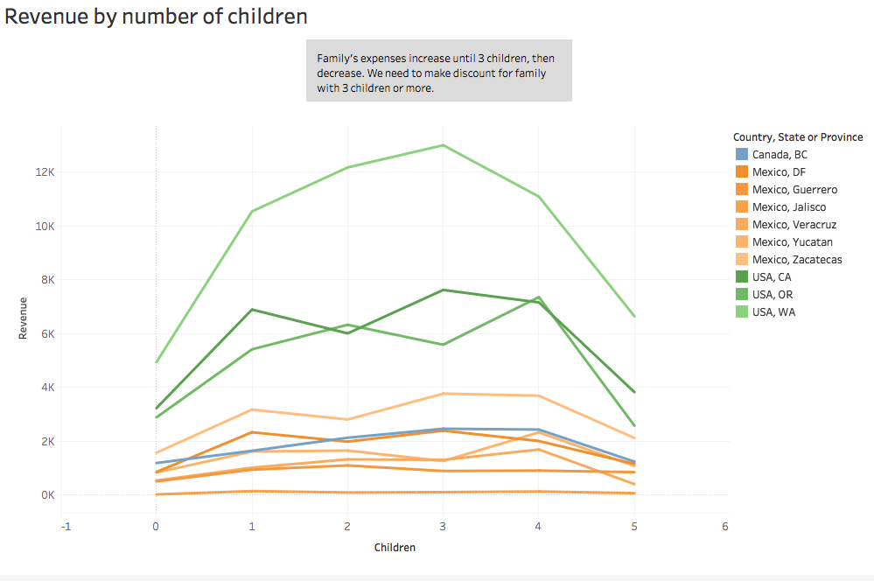
Revenue by number of children by states

Slide 8
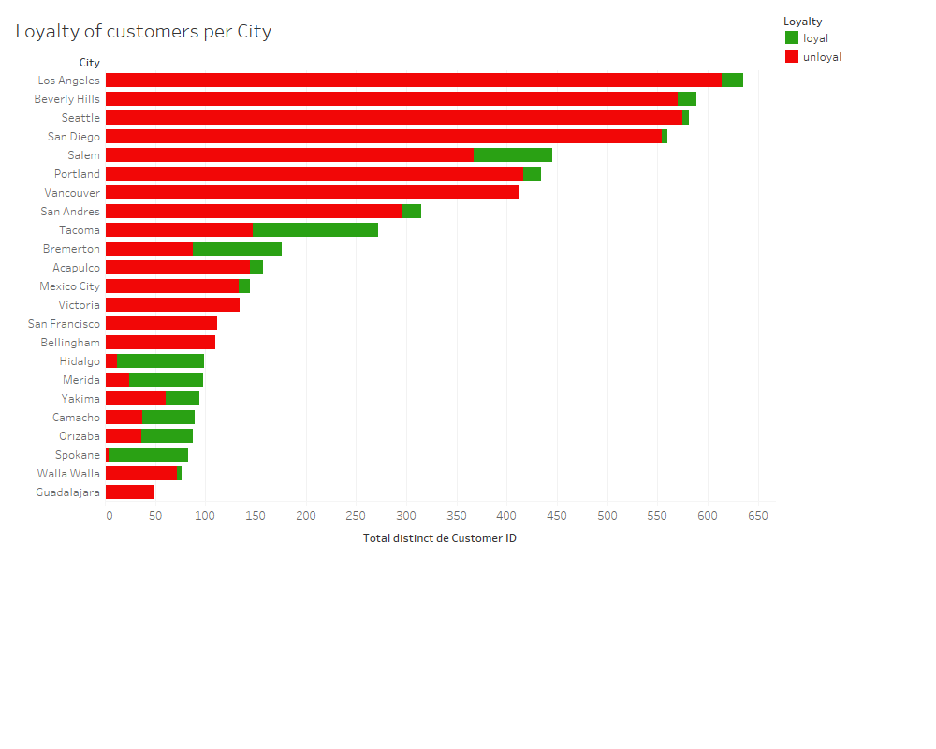

Slide 9
Chief Marketing Officer Recommendation
Discount for big family (more than 3 kids), increase toys and food for kids.
Inspire of Hidalgo, Merida, Spokane, Tacoma stores marketing to increase customers loyalty of the others stores.

Slide 10
3) CFO
Mission | KPI
Analyze the revenue by annual income categories | revenue by annual income categories
Analyze the sum of the revenue by months | revenue by month

Slide 11
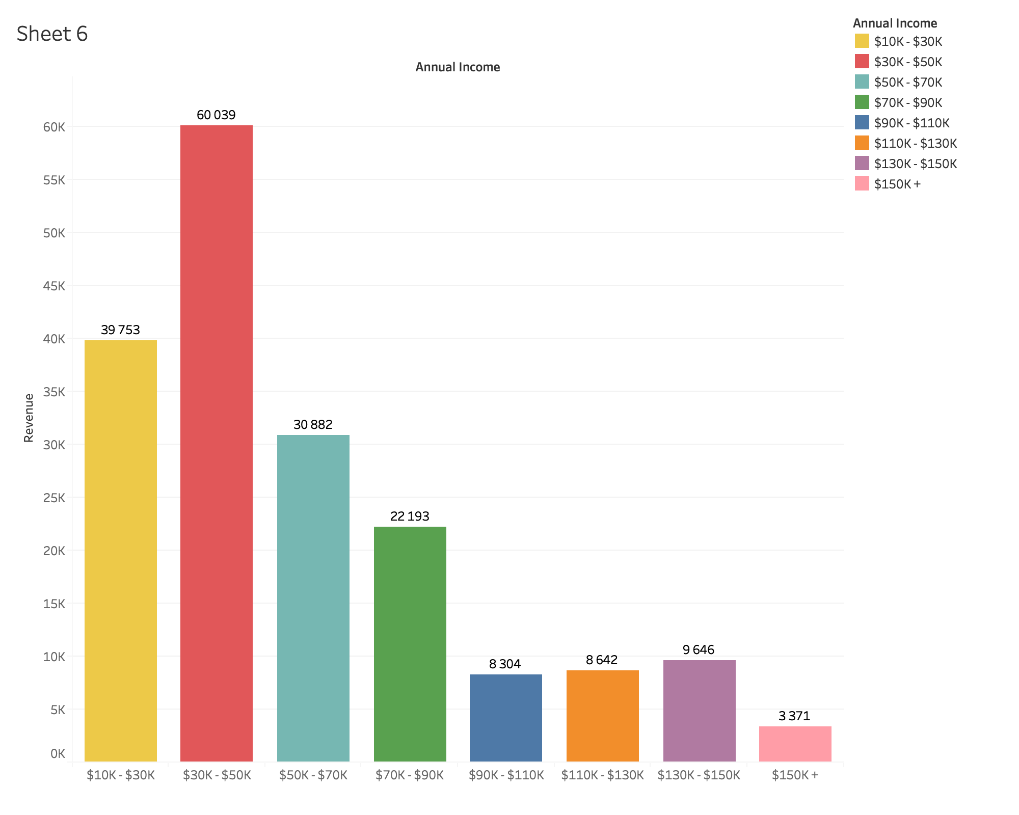
Revenue by annual income categories

Slide 12
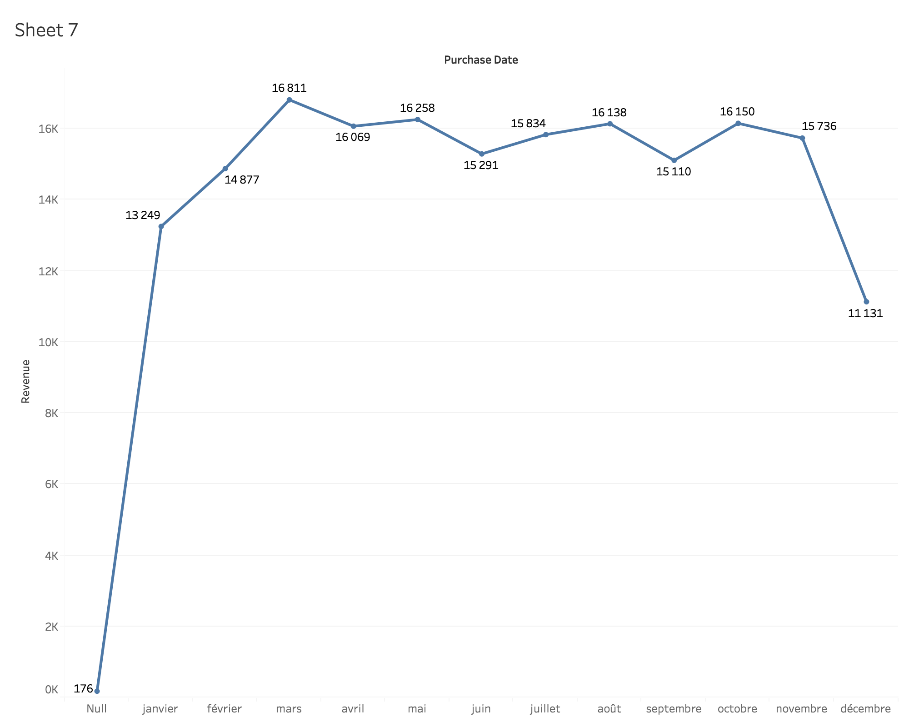
Revenue by month
Huge decrease on December, we have to increase the number of christmas products

Slide 13
CFO Recommendations
For the next period, we have to attract more rich family to spend in our store. To reach this goal, we will sell luxury products, make our stores more attractive and build a luxury brand image. And we have to focus and the 30k-50k range because this is the range where we win the most of our revenu.
Sales are suppose to be high on December, it’s a big period of consumption. We need to sell more Christmas products ( toys and luxury food ).

